Slide 1



Telco Company
Customer
Churn
Lucie Stenger - Ironhack Bootcamp - October 2024

Slide 2



Borcelle Company
Analysis context
churn rate in broader utilities sectors across Western Europe
12-15%
average churn rate for telecom companies
30-35%

Slide 3
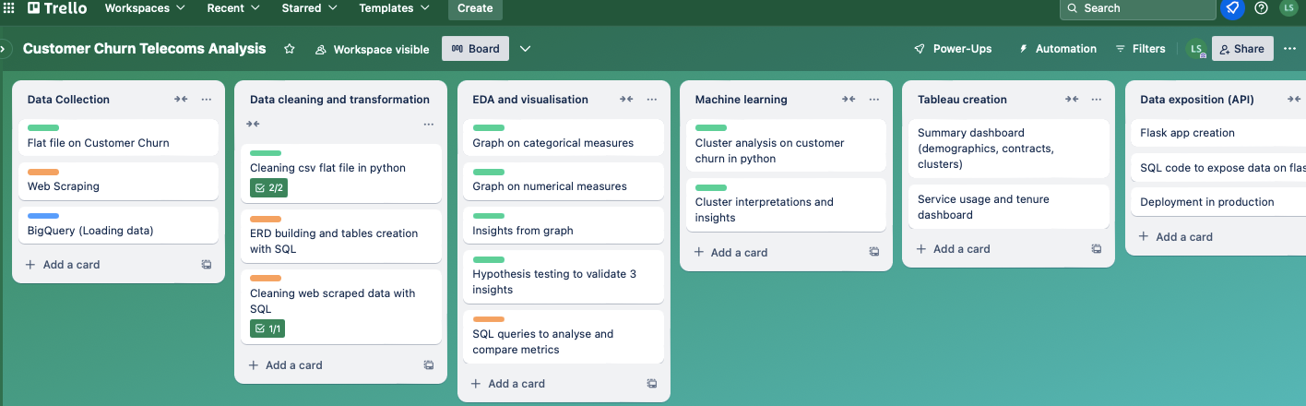
Complementary data on real-life carriers
Web-scraped data
ERD creation
EDA using SQL
Loading data on BigQuery
Api creation using flask
Initial customer churn analysis
Kaggle flat file
EDA using Python
Machine learning with clustering algorithm
Tableau creation

Slide 4

Kaggle.com
flat file
Whistleout.com web-scraping
Customer demographics
Account information
Services subscribed
Customer churn
Best phone plans per category
Best bundle plans per category
Carriers list and internet plans
T-Mobile family plans

Slide 5



Borcelle Company
Reducing churn rate
Analysing
Clustering
Predicting
Analysing customers’ profiles, accounts information, and services used.
Identifying common behaviors and profiles to then group customers into segments with similar characteristics.
Identifying
factors impacting the churn rate, and coming up with recommendations to reduce it.

Slide 6


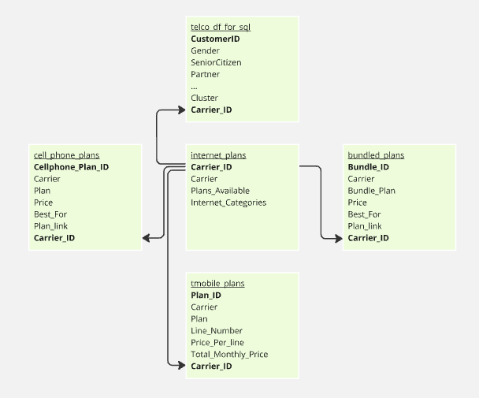

Entity Relationship Diagram

Slide 7



Exploratory Data Analysis (EDA)
Customers are more likely to churn if:
01
They have no dependent and no partner
05
They have fiber optic Internet service
02
They are a senior citizen (older than 65y)
06
Their contract is month-to-month
03
They are recent customers (less than 1 year)
07
They pay via electronic check
04
08
They subscribe to Internet but do not subscribe to Online security, Online backup, Device protection, or Tech support services
They have multiple lines

Slide 8
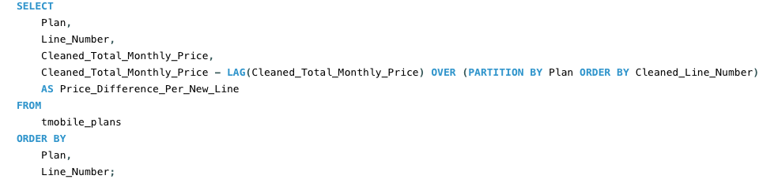
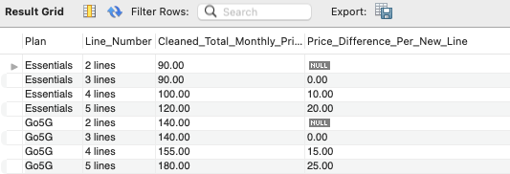
Exploratory Data Analysis (EDA)
Customers are more likely to churn if:
04
They have multiple lines
T-Mobile family plans offer savings on multiple lines in order to reduce churn rate.
Savings are even larger when analysing the total cost for 2 lines versus 3 lines in various phone plans.

Slide 9
Hypothesis Testing
Customers who have been using Telco's services for over one year are less likely to churn.
Customers with month-to-month contracts are more likely to churn.
Senior citizens are more likely to churn than non-senior citizens.
Null Hypothesis (H₀): Customers who have been using Telco’s services for over one year are equally likely to churn as those who have been using it for less than or equal to one year.
Alternative Hypothesis(H₁): Customers who have been using Telco’s services for over 1 year are less likely to churn.
Chi-Square Statistic: 708.78
P-Value: 0
We reject the null hypothesis.
Null Hypothesis (H₀): Customers with month-to-month contracts are equally likely to churn as those with other types of contracts.
Alternative Hypothesis (H₁): Customers with month-to-month contracts are more likely to churn.
Chi-Square Statistic: 1153.97
P-Value: 0
We reject the null hypothesis.
Null Hypothesis (H₀): Senior citizens are equally likely to churn as non-senior citizens.
Alternative Hypothesis (H₁): Senior citizens are more likely to churn than non-senior citizen
Z-Statistic: 12.663
P-Value: 0
We reject the null hypothesis.

Slide 10
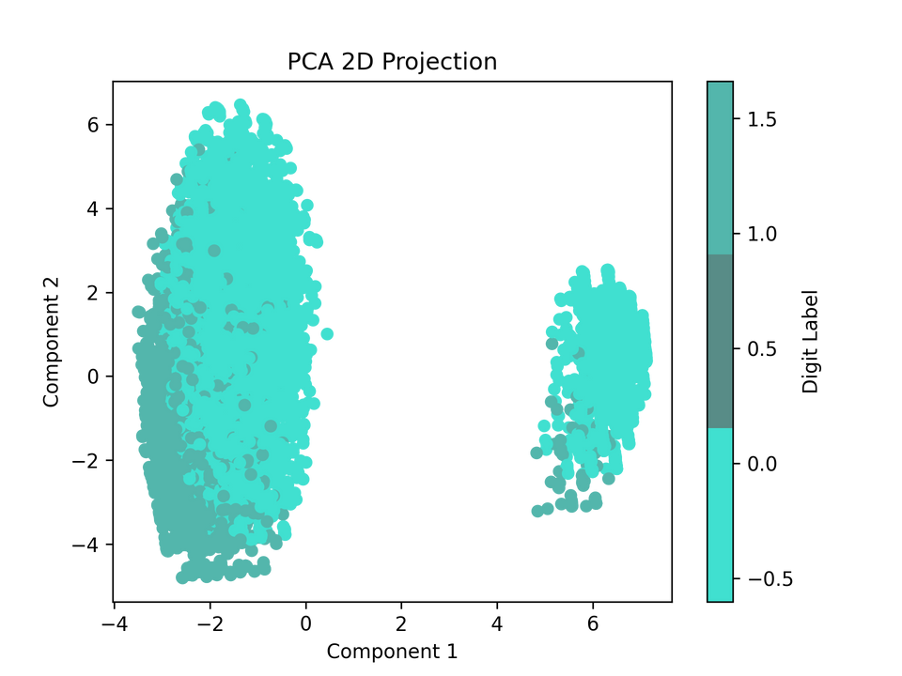

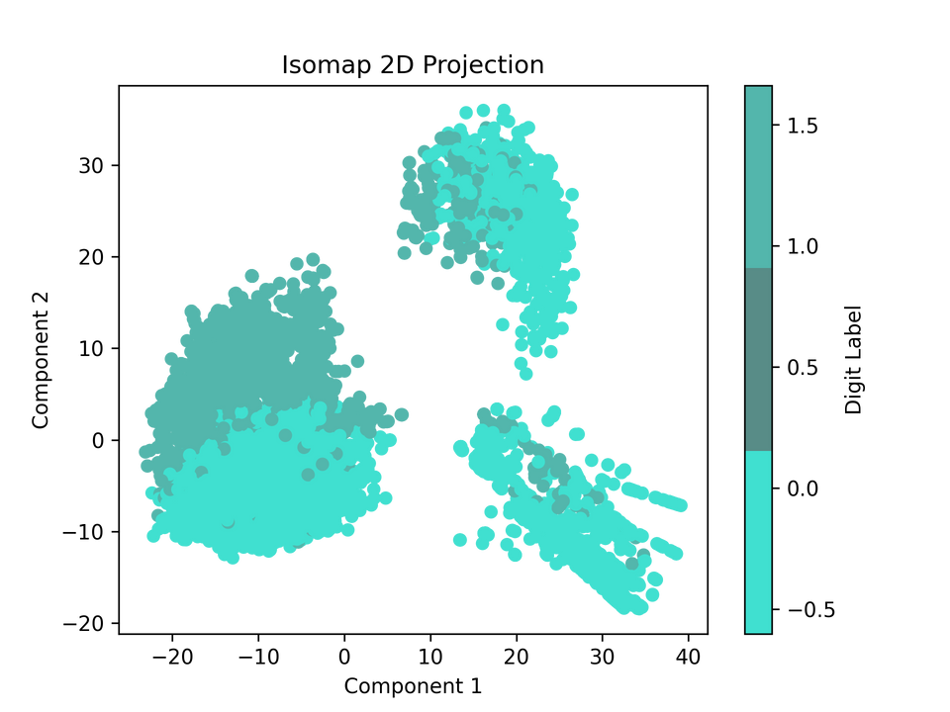
Clustering Algorithms
Step 1:
Transforming categorical features in numerical (dummification).
Step 2:
Standardising the numerical data.
Step 3:
Performing a dimensionality reduction method:
PCA may not be optimal as the first two components explain only 0.38 of the variance, which is less than 80%.
Isomap method seems to be more relevant than PCA for the 2D projection as we discovered a 3rd cluster.

Slide 11
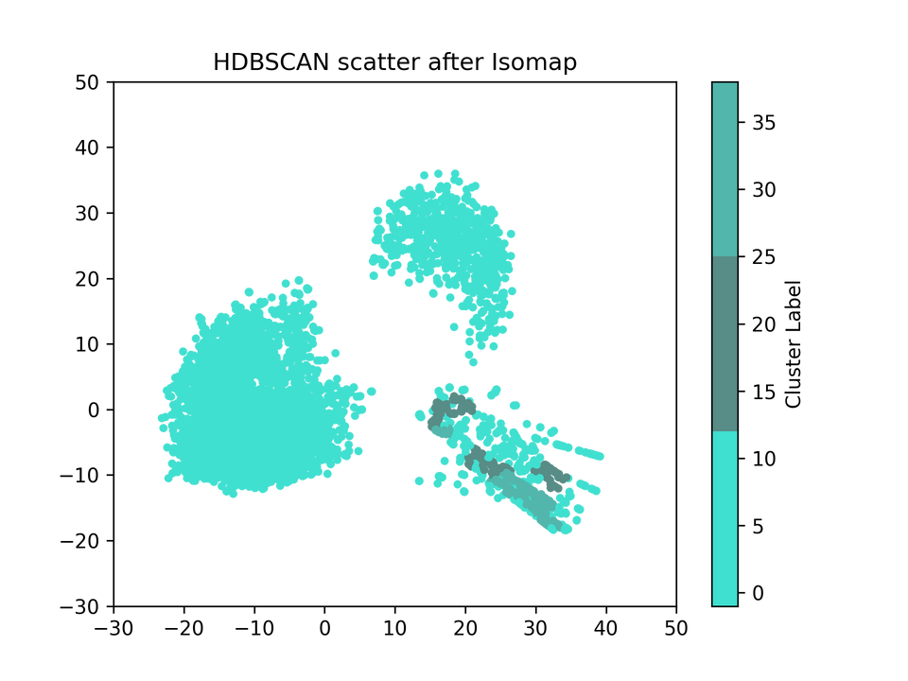
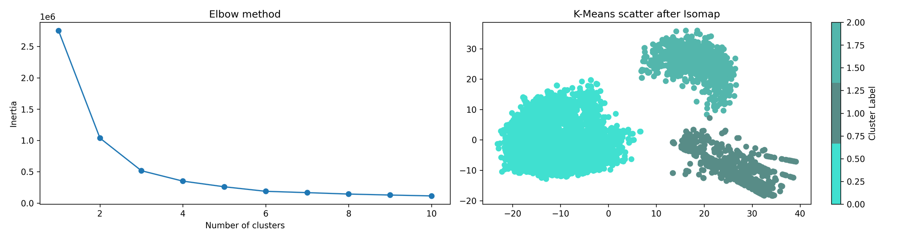
Clustering Algorithm
Step 4:
Clustering our data:
K-means
HDBSCAN

Slide 12

Clusters
0
1
2
Using both telephone and Internet services
Mostly have no dependent
Mostly have month-to-month contract, paperless billing and paying with electronic check
Median monthly charge is 80$
33% chance of churn
Using telephone but no Internet service
Mostly have 1 line
Mostly under 65 years old
Paying less than 30$ monthly, mostly via mailed check
Less than 10% chance of churn
Using DSL Internet service only, no telephone service
Paying between 0 and 80$ monthly, with the majority of customers paying between 30$ and 50$.
About 25% chance of churn

Slide 13
Tableau dashboard

Slide 14
Recommendations
Churn prevention:
All clusters: Retain sernior citizens with personalised offers.
Cluster 0: Retain customers with specific offers on additional internet service when using Fiber Optic, especially Online Backup and Device Protection. Run bundle offers to align with competitors. Intensify these offers in the first year of subscription.
Cluster 2: Run special offer on Tech Support.
Loyalty program
Cluster 1: Reward customers to maintain engagement.
Upselling
All clusters: Run incentive to subscribe to multiple telephone lines.
Cluster 1: Offer service upgrades, such as internet services.

Slide 15
Improvements
Additional measures like satisfaction score, customer lifetime value, or subscriptions’ prices
Information on competitors
Set-up a system to match customers to the most appropriate plan

Slide 16

Telco Company
Thank You!
Lucie Stenger
Ironhack Bootcamp
October 2024

Slide 17
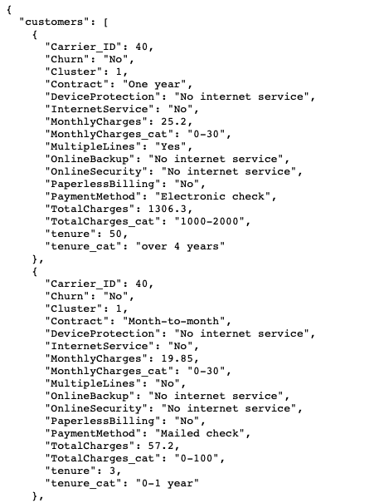
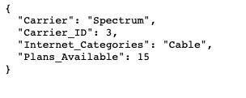
Borcelle Company
Appendix - Flask API
http://localhost:8080/carrier/3
http://localhost:8080/Telco/cluster?page=0&page_size=10&cluster=1&gdpr=0

Slide 18
Borcelle Company
Appendix -
GitHub repository
GitHub repository link

